Slide 1
Open-loop data generation of system with MSD
  Only standstill multisine excitation
    8 total
      6 training
      2 validation
  Replay in open-loop for baseline model
Open-loop augmentation training
  Linear encoder init
  baseline + ANN
Controller design
  Question

Slide 2
Training Trajectories

Slide 3
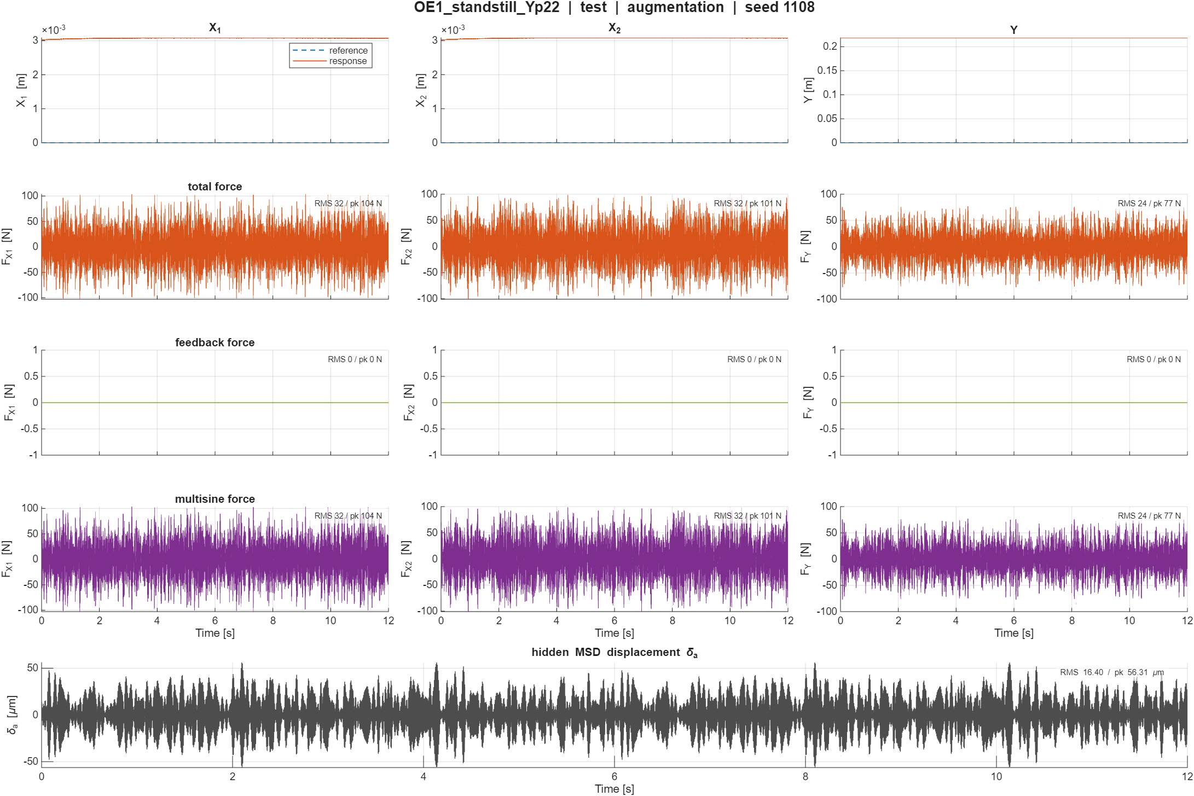

Slide 4
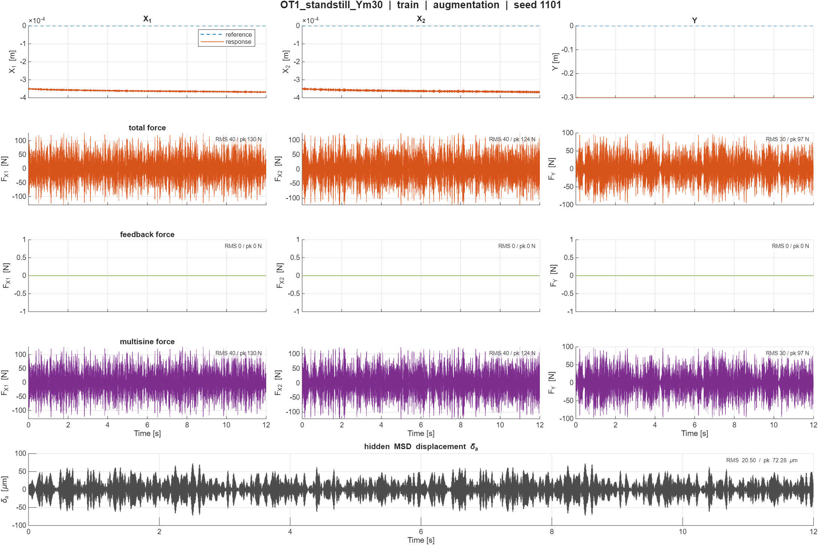

Slide 5
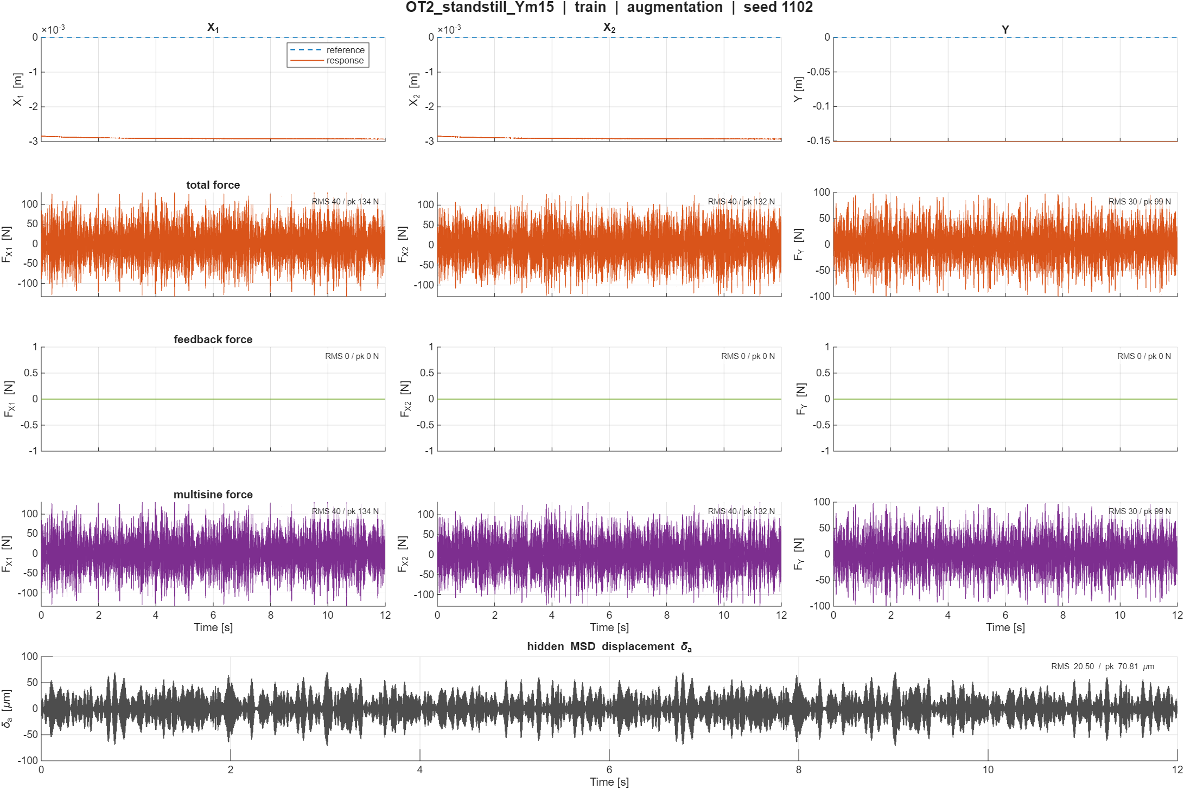

Slide 6
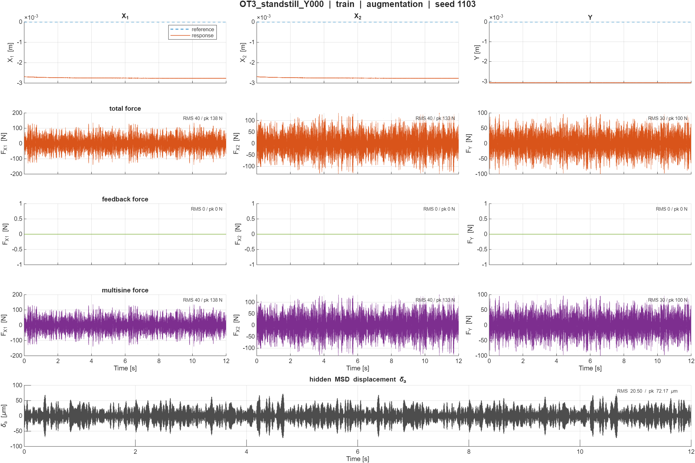

Slide 7
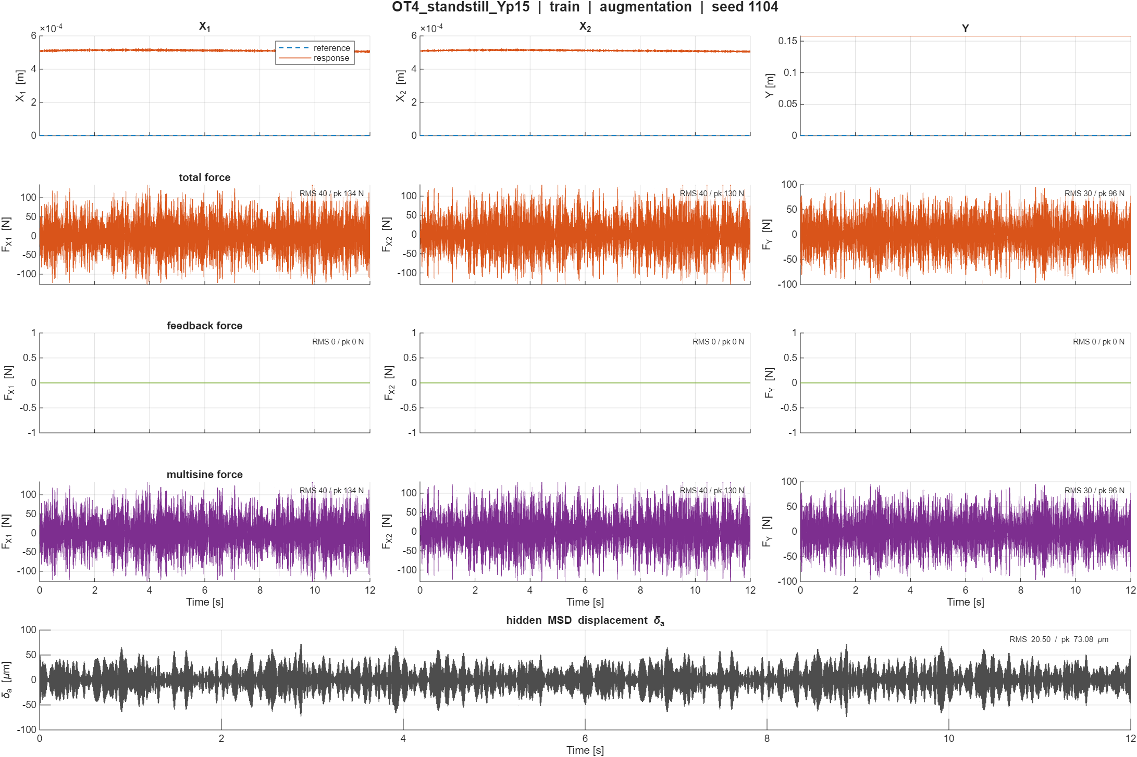

Slide 8
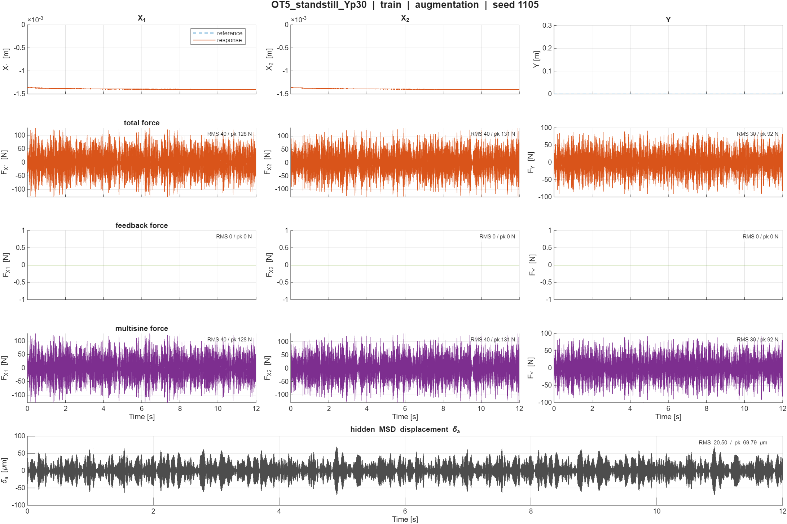

Slide 9
Validation Trajectories

Slide 10
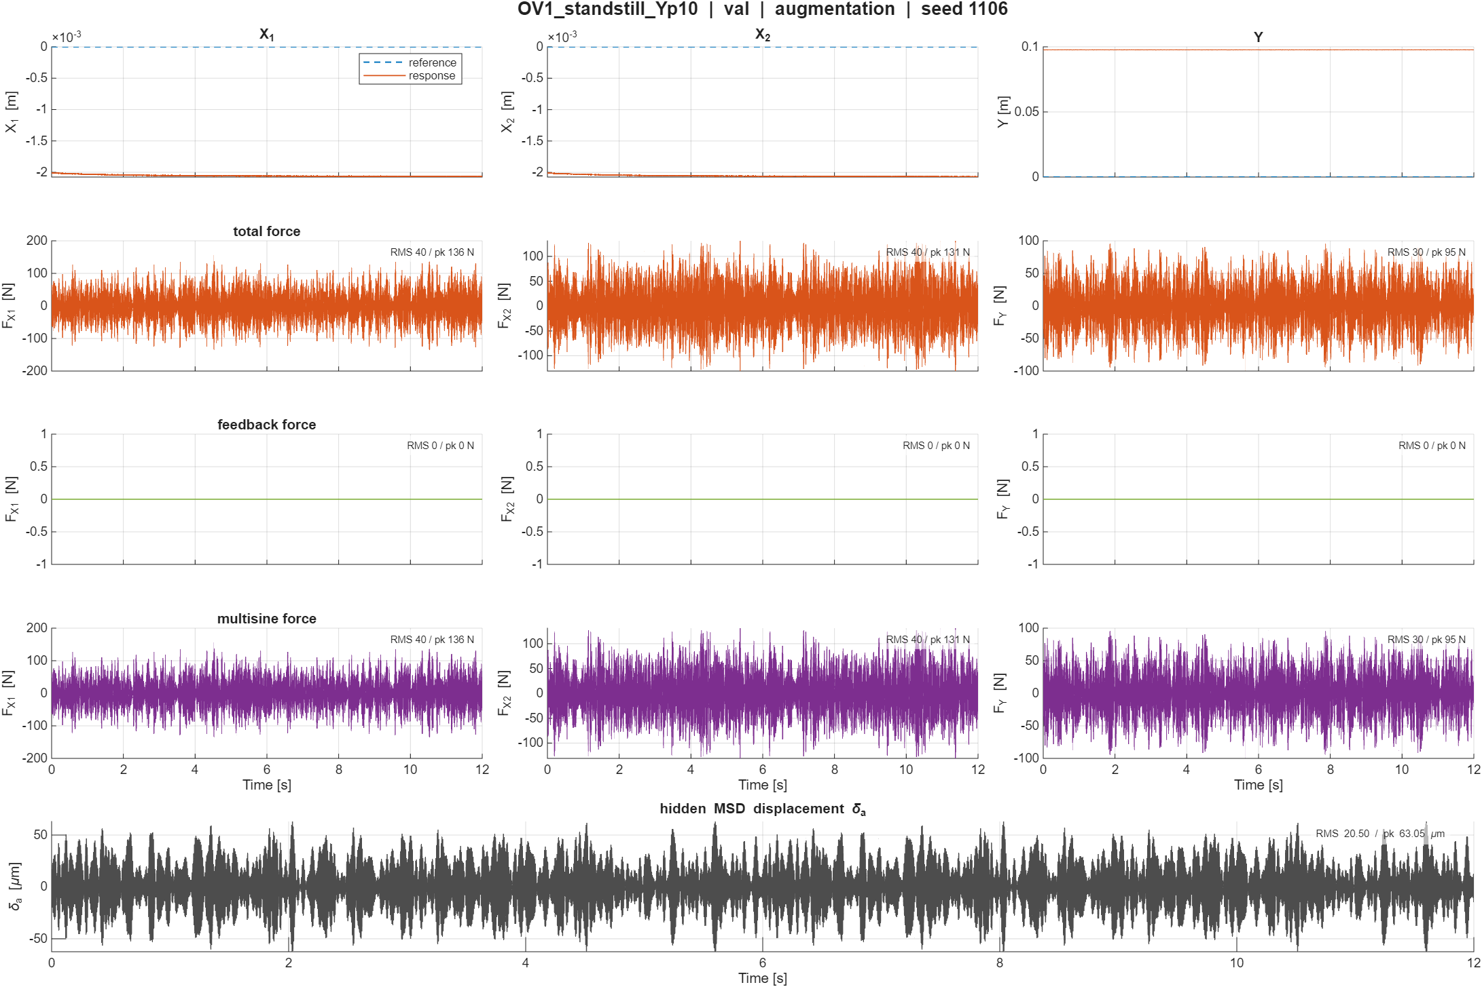

Slide 11
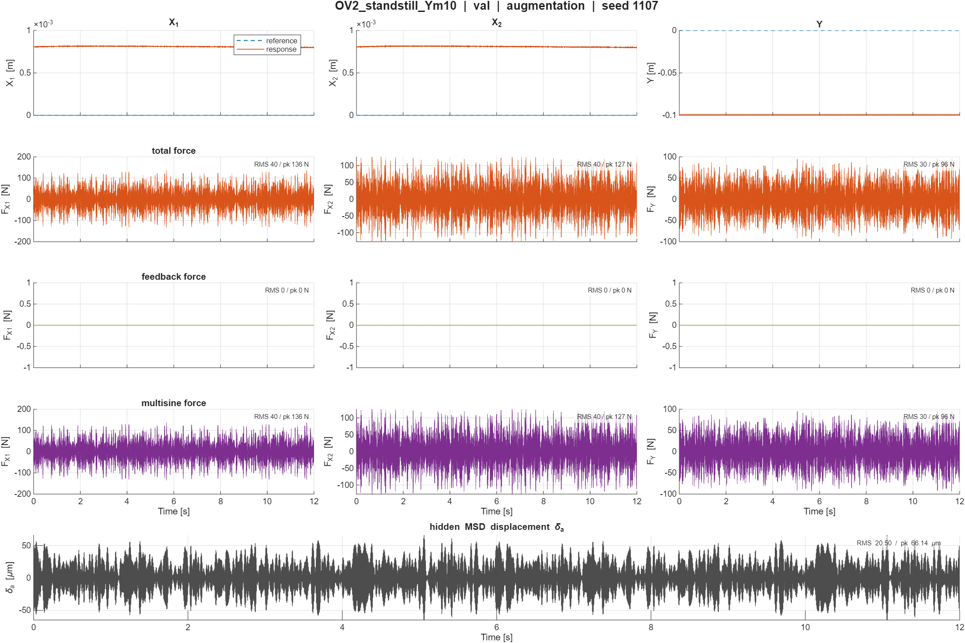

Slide 12
Replay open-loop
System data recorded in open-loop
All standstill
No reference because only input now without controller

Slide 13
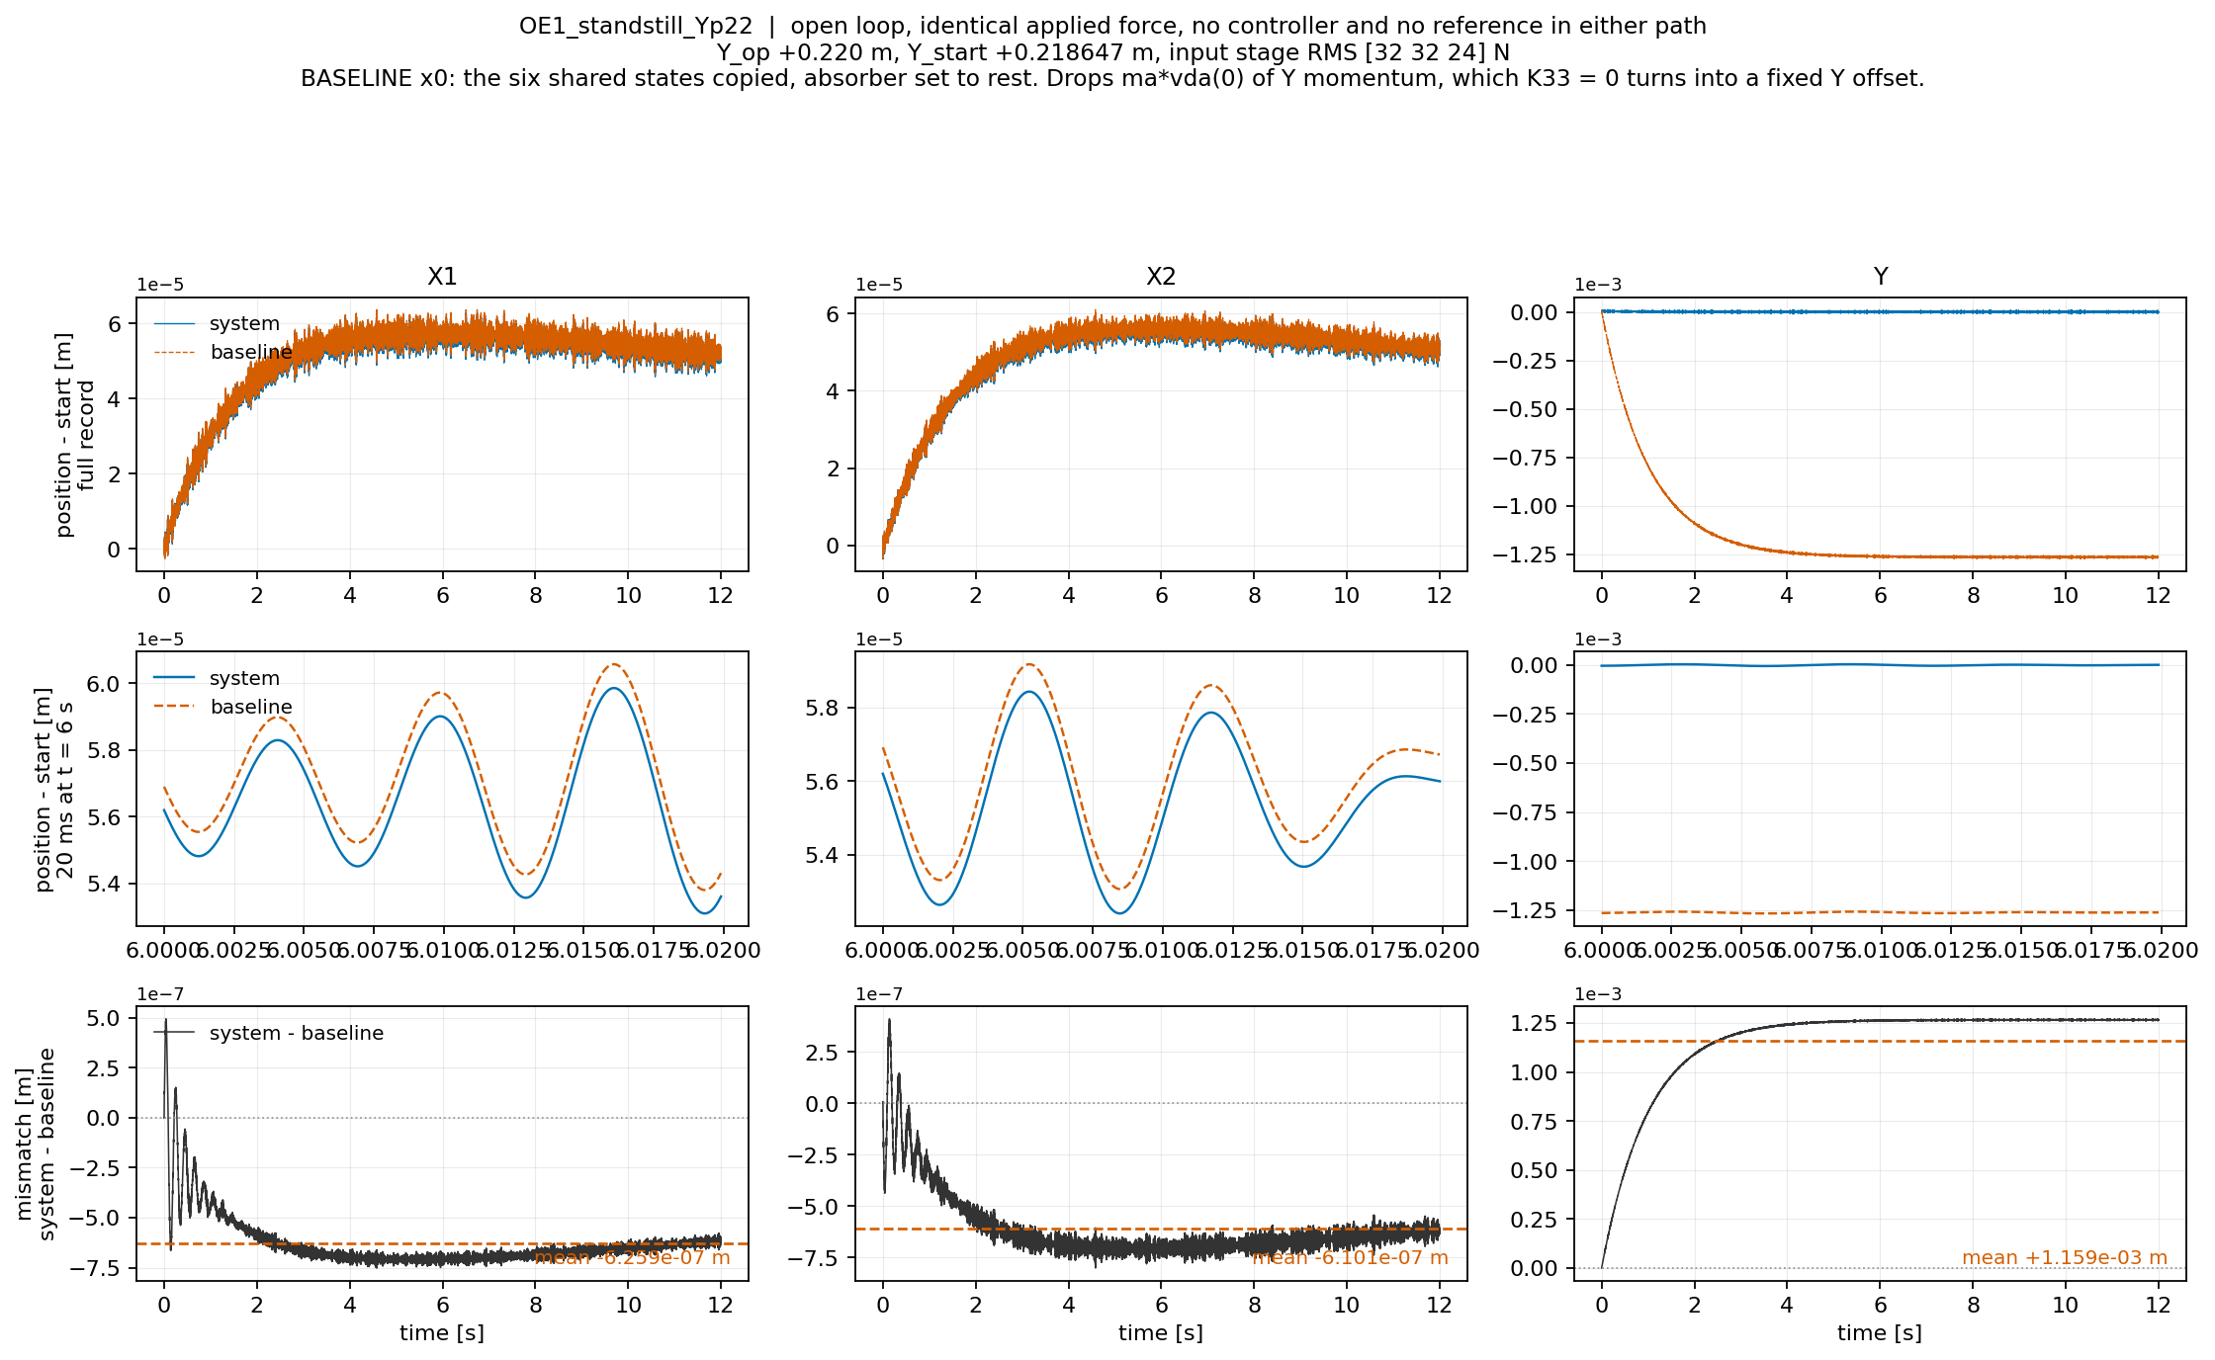

Slide 14
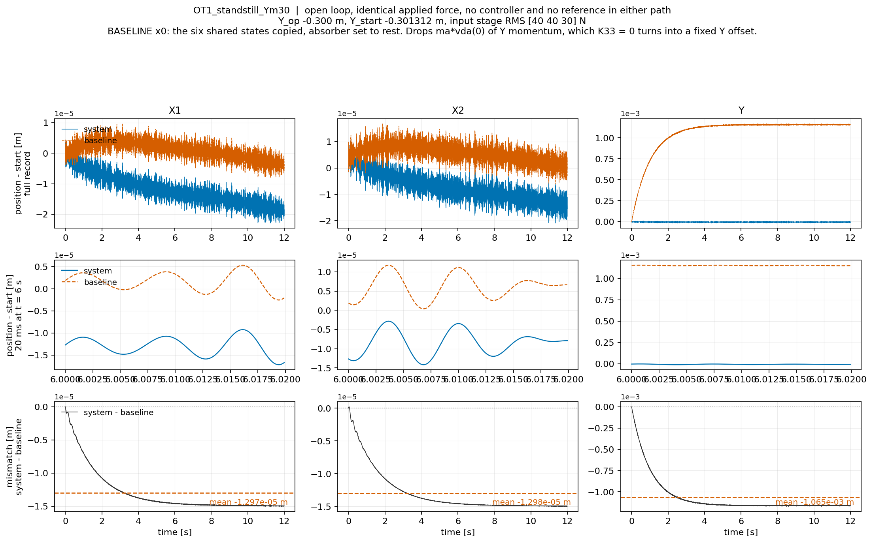

Slide 15
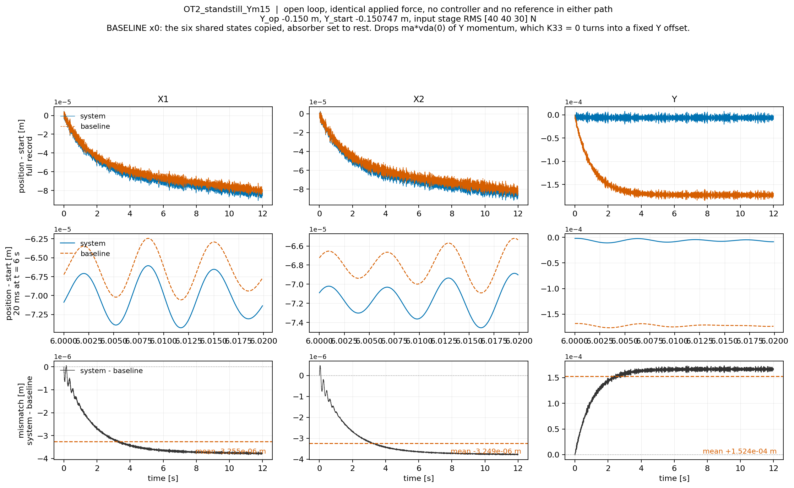

Slide 16
Add momentum of absorber
For dY add the momentum of the absorber
  Both models carry the same 10.1 kg payload. The system splits it into a rigid part and a 1.01 kg absorber; the baseline keeps it as one rigid mass.
  Seeding the baseline with the shared states matches position and payload velocity, but not the absorber's momentum.
  Y has damping cy but no stiffness (K33 = 0). With no restoring force, the excess momentum can only travel through the damper.
  → Result: a fixed position offset
This is what the augmentation needs to learn
  Mismatch due to absorber absent
Notes:
, dY = ma * vda(0) / cy

Slide 17
seeding
To draw the baseline curve I have to integrate the 6-state model forward from somewhere. The record stores the system's 8-state initial condition, [X, Th, Y, da, dX, dTh, dY, vda]. The baseline has only six of those states, no da and no vda, because it has no absorber.The obvious thing, which is what I did first, is to copy the six states they share and drop the other two. That is wrong in a specific way. The absorber is a mass ma = 1.01 kg moving at vda(0), which at the record's first sample is up to 0.043 m/s. That is real Y momentum, ma * vda(0), and dropping the state drops the momentum with it. The baseline starts physically lighter in motion than the system it is being compared to.Normally a small momentum error would decay. Here it cannot: K33 = 0, Y has damping but no stiffness, so there is no restoring force and the momentum difference converts into a permanent position difference of ma * vda(0) / cy. With cy = 10 Ns/m that is millimetres, against a real model discrepancy of 2e-06 m. So the panel was showing my choice of initial condition, three orders larger than the physics.

Slide 18
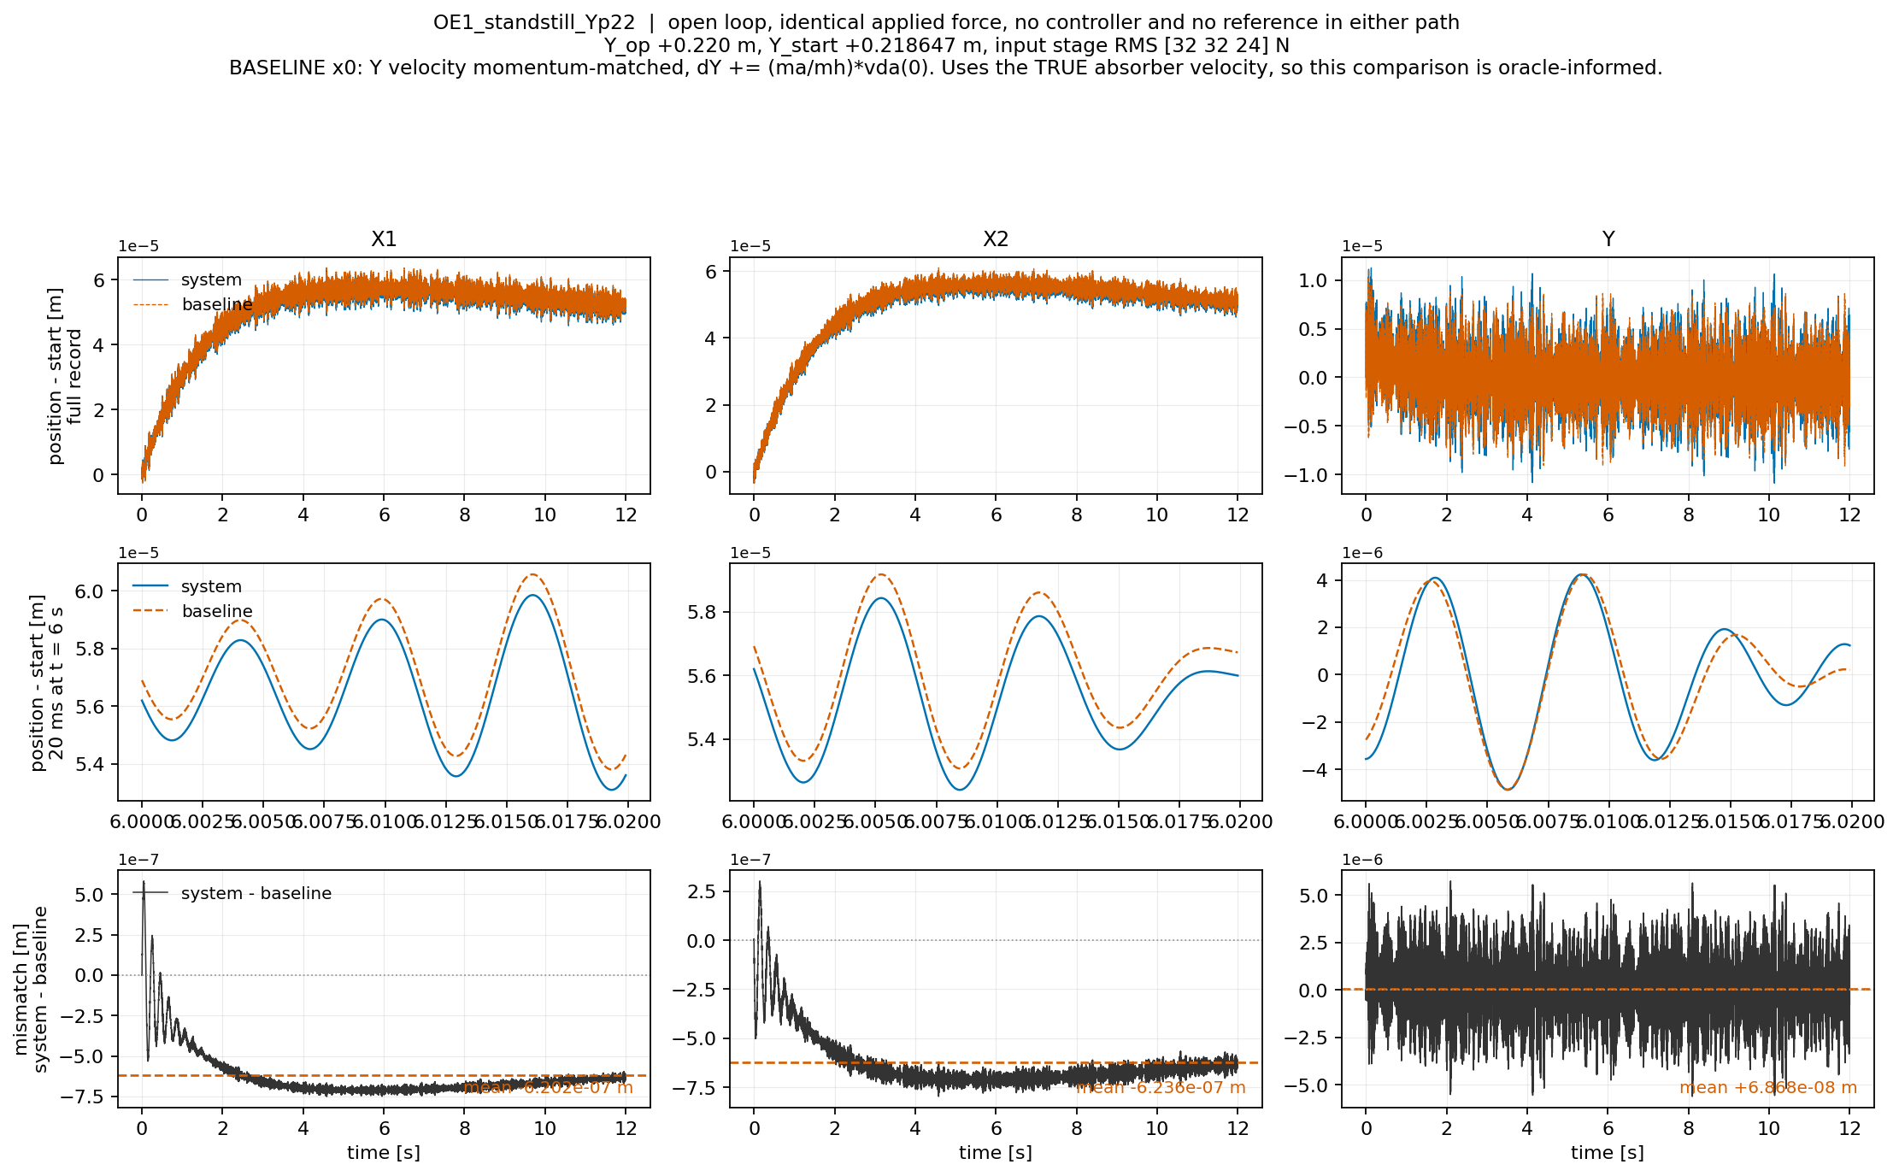

Slide 19
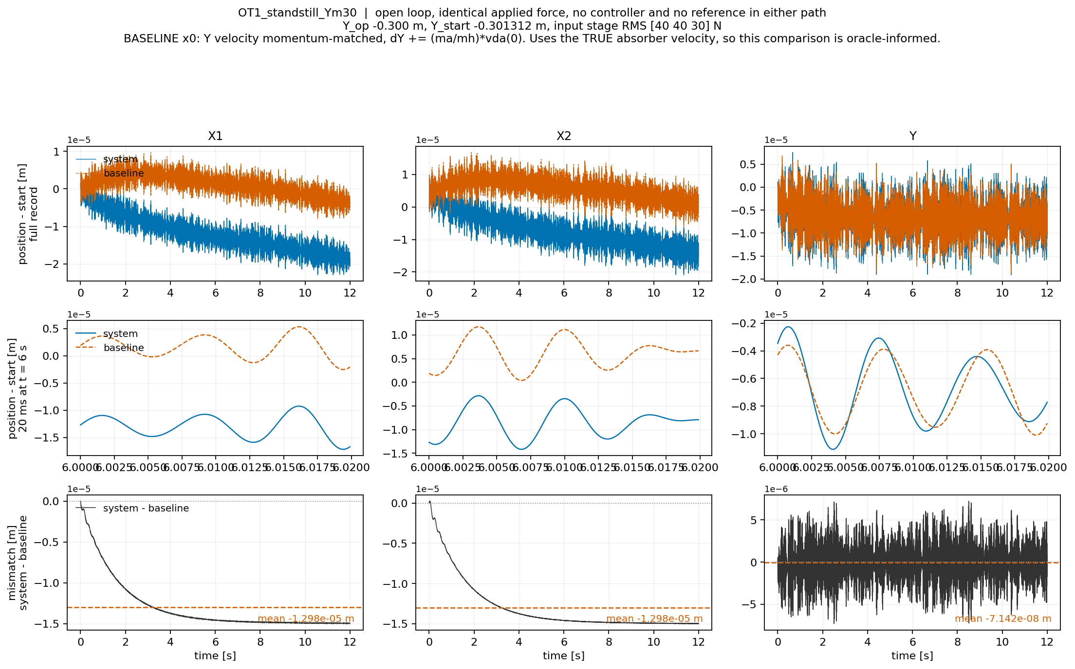

Slide 20
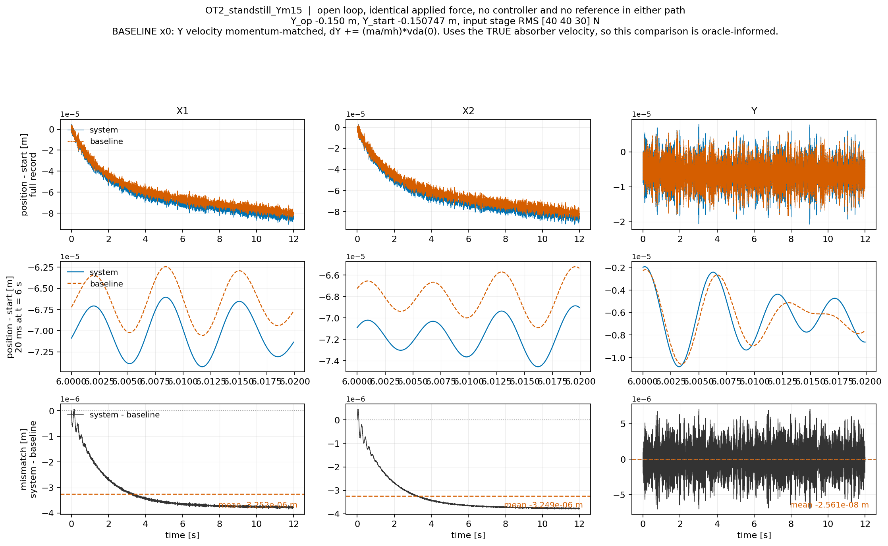

Slide 21
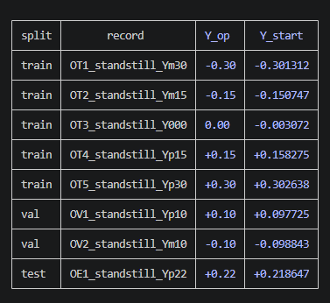
Baseline + ANN
Training
Momentum “fix” not included
Less data, only standstill no reference

Slide 22
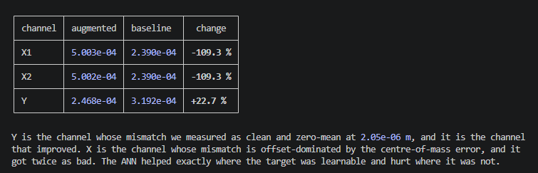

Slide 23
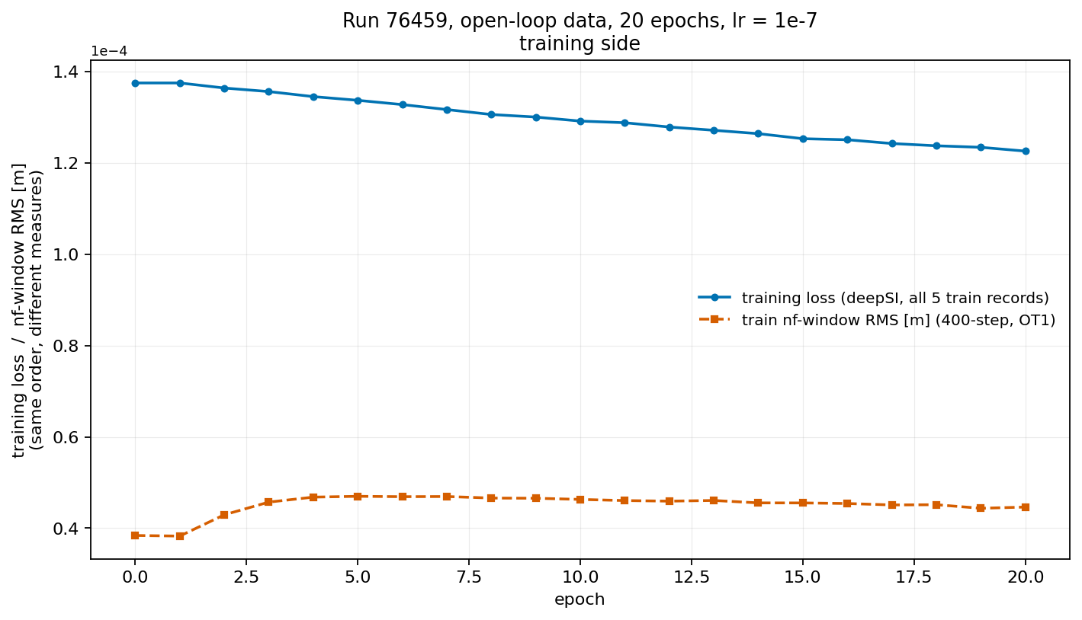

Slide 24
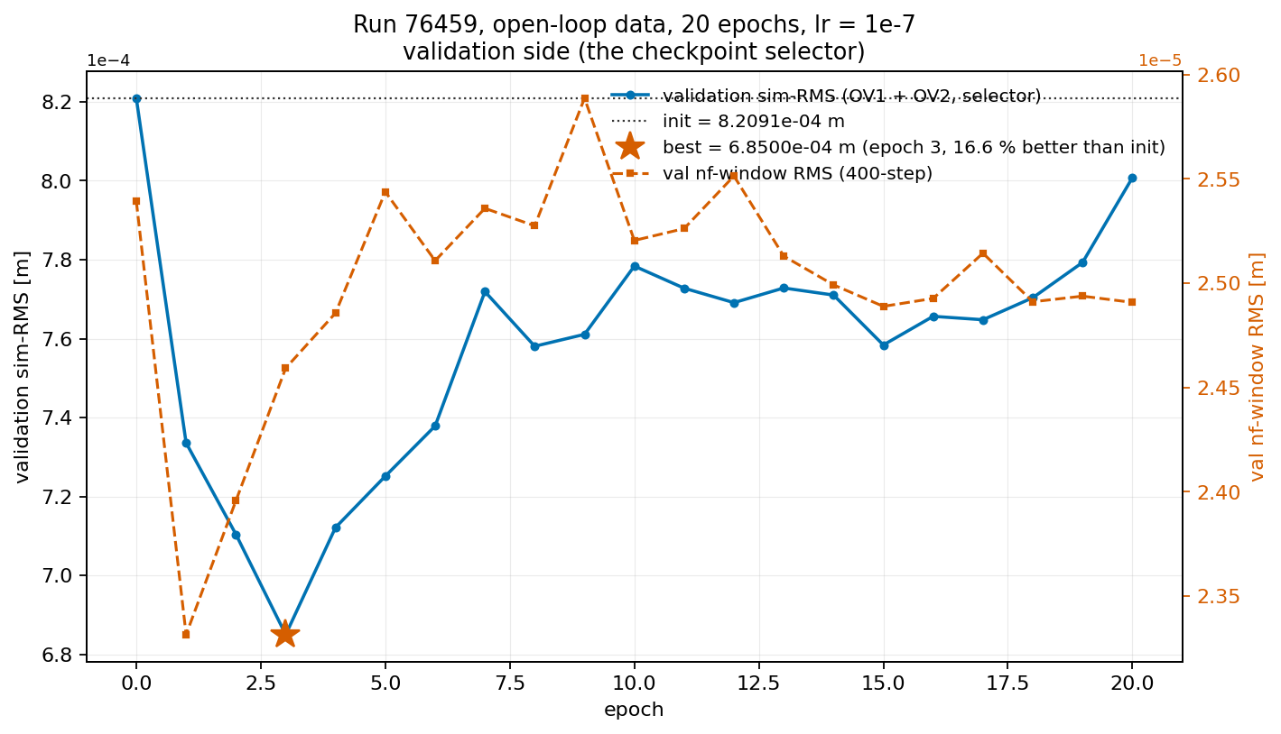

Slide 25
Mismatch training window and validation window

Slide 26
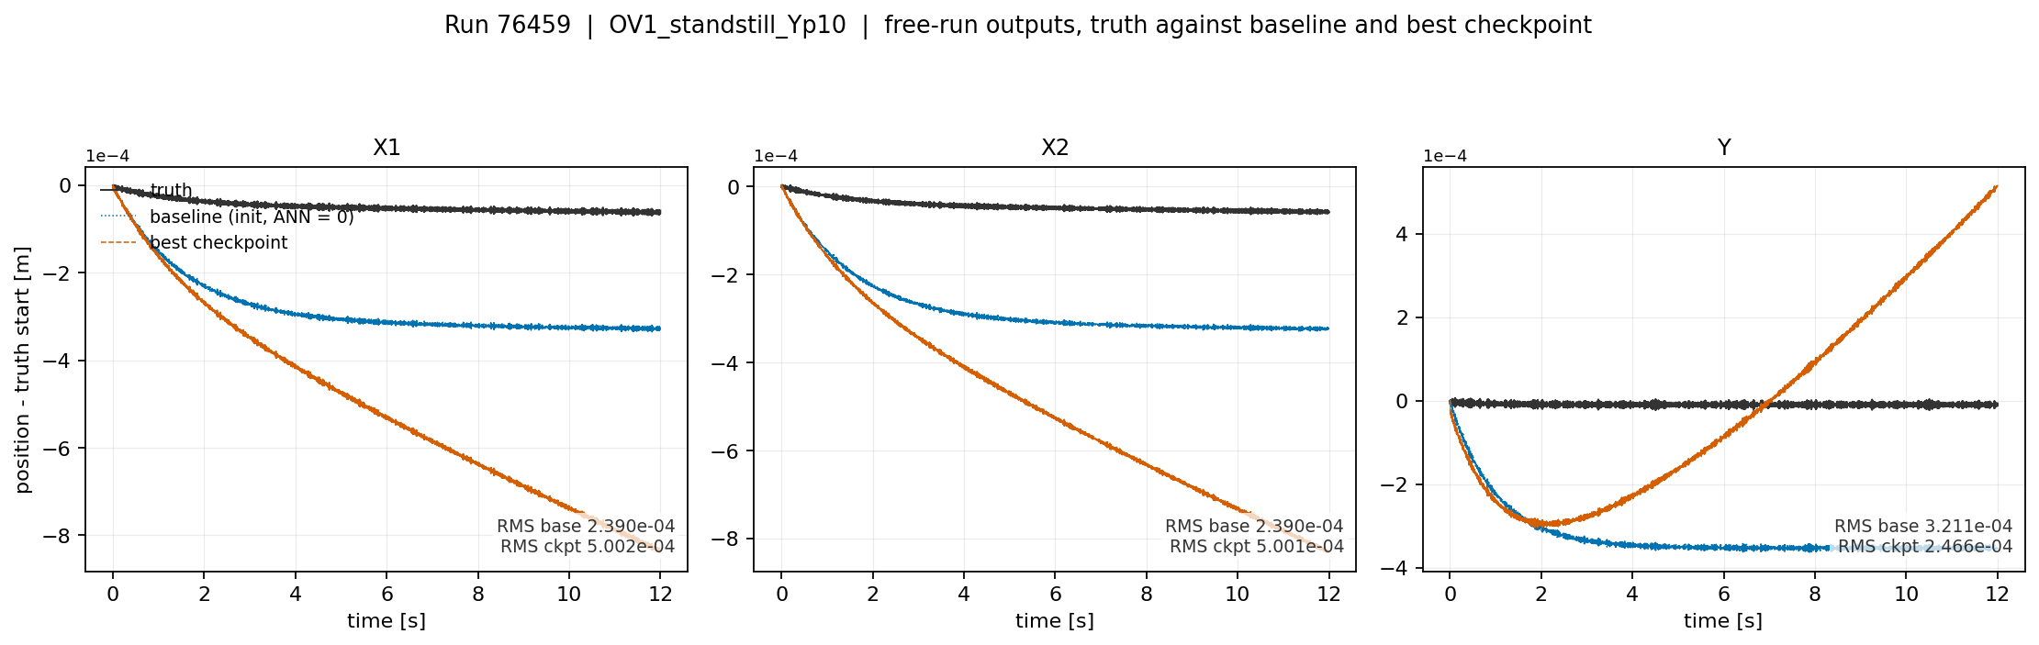

Slide 27
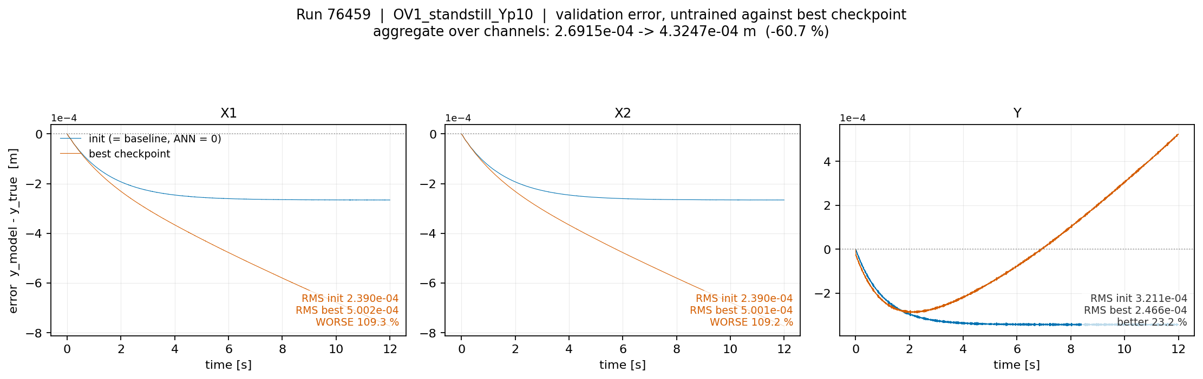

Slide 28
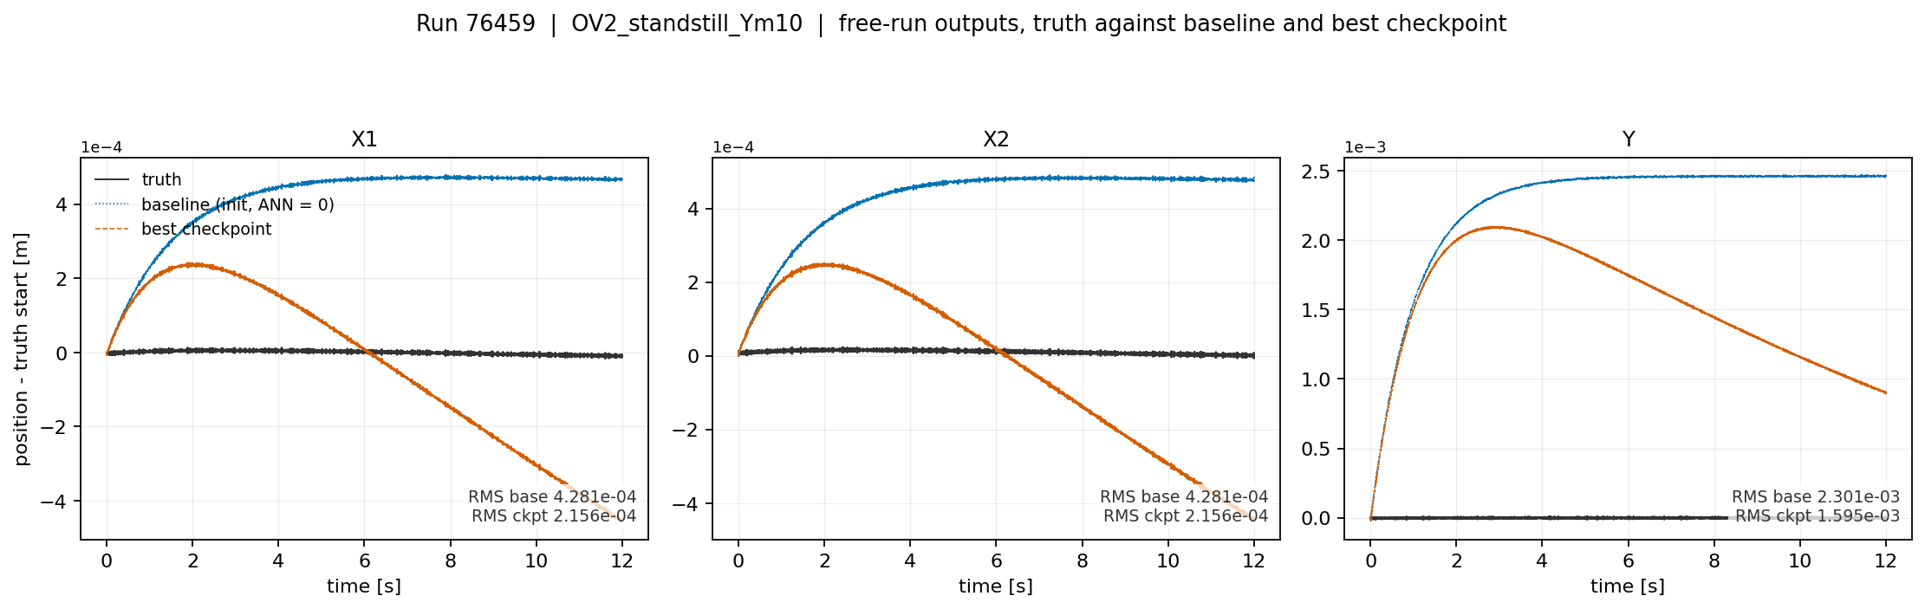

Slide 29
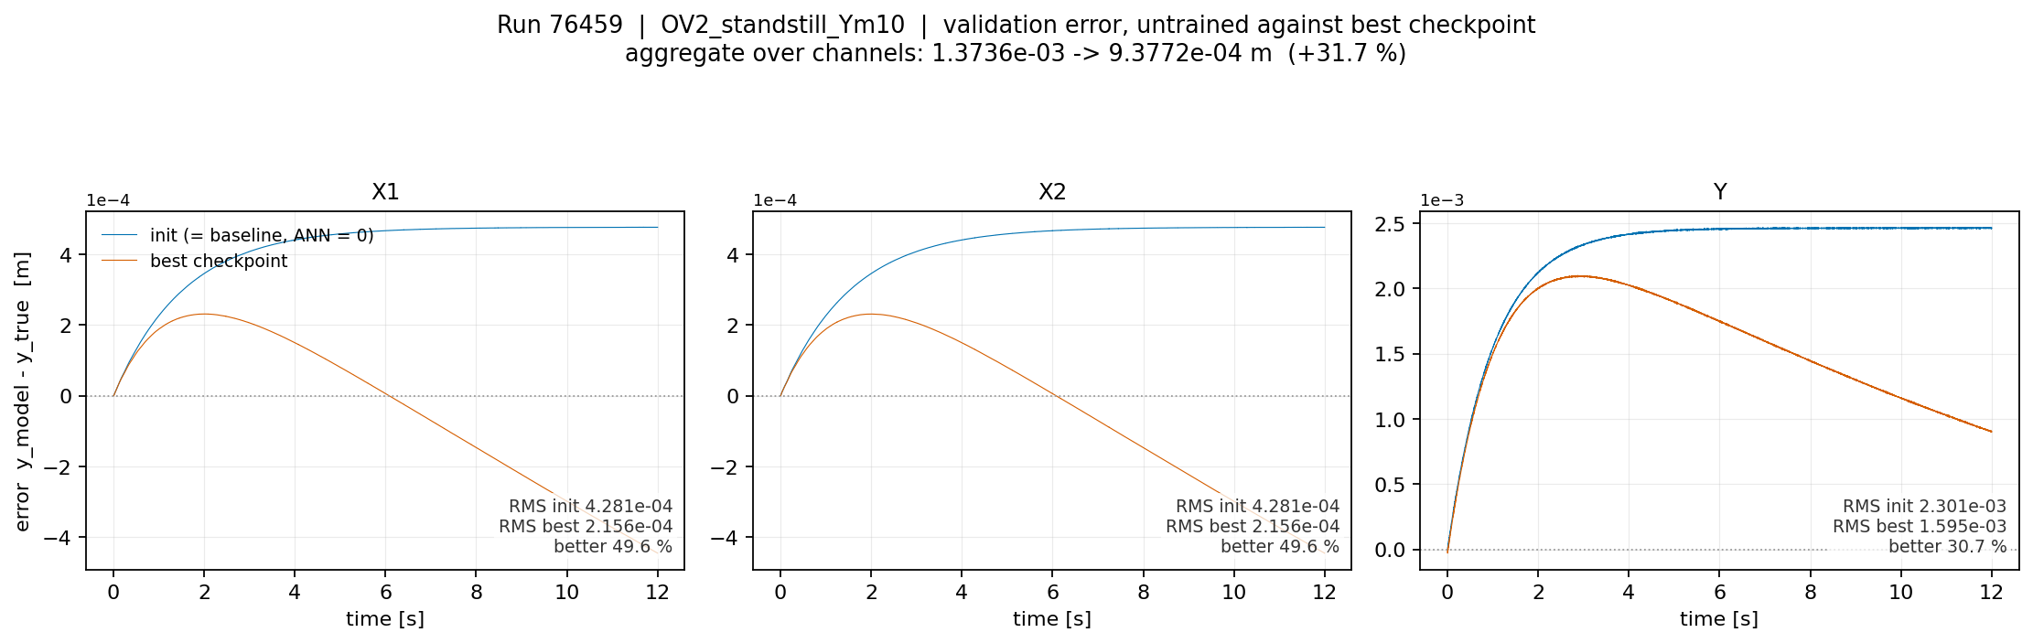

Slide 30
Controller
System Identification Lecture 11: Closed-loop Identification

Slide 31
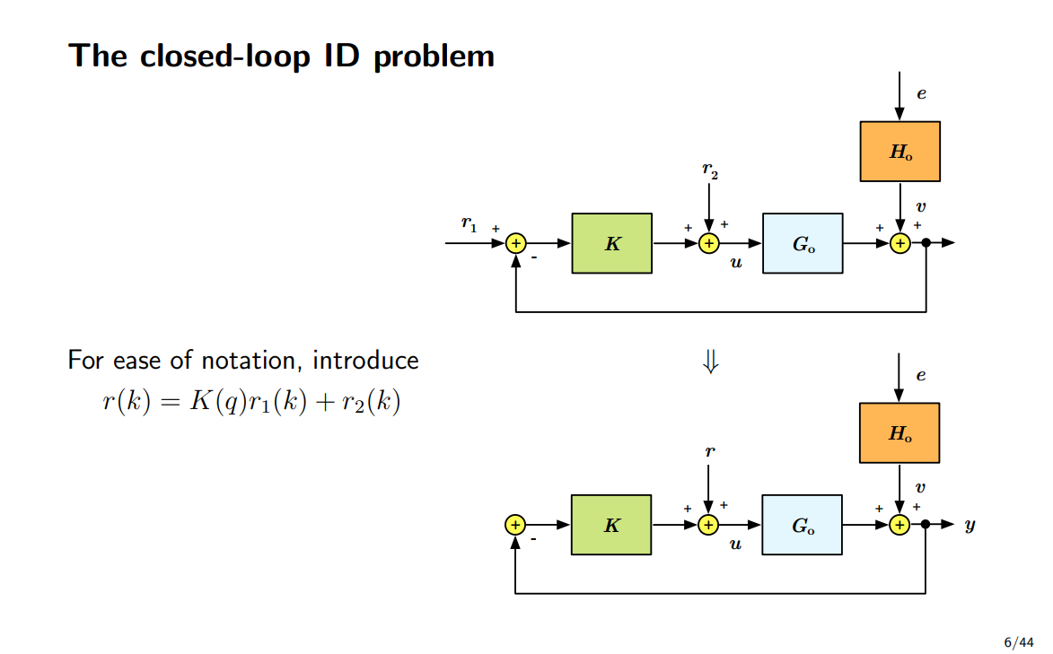

Slide 32
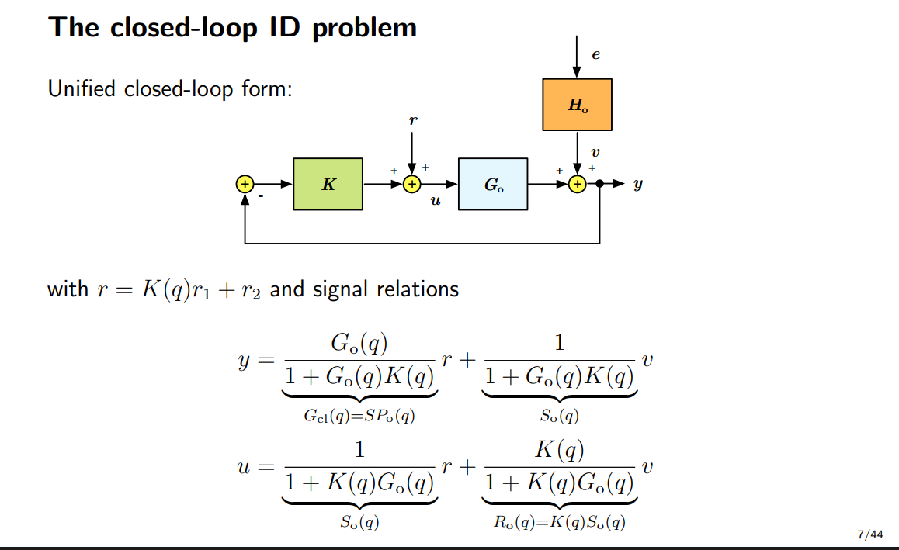

Slide 33
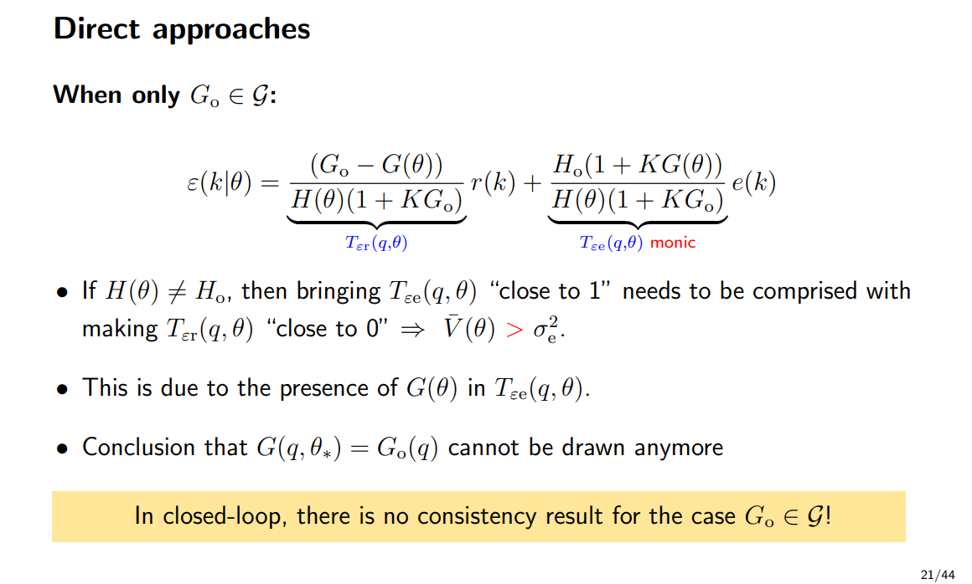
Notes:
No noise V=0

Slide 34
Question
What to do with the controller states during training? For windowed training
Not part of the subnet encoder?
Options:
  Drive the loop from r
  Drive the loop from the recorded input

Slide 35
Write out controller
Step 1:
  Read the three factors out of ruleOfThumb.m. With fbw = 100 Hz and w = 2*pi*fbw
    integrator (s + w/6) / s
    lead-lag (s + w/3) / (s + 3w)
    roll-off 10w / (s + 10w)
Step 2:
  Multiply them into one transfer function
  Cnorm(s) = 10w (s + w/6)(s + w/3) / [ s (s + 3w)(s + 10w) ]
  Numerator degree 2, denominator degree 3. One pole at the origin, that is the integrator.

Slide 36
Step 3:
  Build the plant the controller is normalised against
  M(Y_op) frozen at the operating Y
  Transform state space to stage frame instead of logical coordinates
Step 4:
  Compute the gain, one per channel
Step 5:
  Scale: Three SISO controllers, same shape, different gains.
Step 6:
  Discretise
Step 7:
  Realise as state space
  I will get controller states
Step 8:
  Connect it to the first-principles model
Notes:
Step 4. Compute the gain, one per channelEvaluate at the design frequency s = i*w and take the diagonal entries:kappa_j = 1 / | sys_jj(i w) · Cnorm(i w) | j = 1, 2, 3This forces |kappa_j sys_jj Cnorm| = 1 at 100 Hz, so each channel crosses over at the design bandwidth.

Slide 37
Controller state init
Bas Kessels
4. His only reason SUBNET fails closed-loop is random initialisation into instability, not an information argument. He never engages the sigma_max(So) = 0.021 attenuation objection in section 8. So the "against" argument in the handoff remains unanswered by this reference.
1. The controller-state initialisation fix is his Remark 5.4 (p. 157). Since f_FB and g_FB are known, the FB states are either read from the machine or reconstructed from measured y, known r and the controller. In the industrial case (p. 171) he does exactly that: FB states extracted from measurement data, not encoder-initialised. Our zero-init is not a variant of his method, it is a defect relative to it. The handoff's planned fix is the literature-correct one.

Slide 38
Well posedness closed-loop
- Well-posedness of the loop closure, which needs I + D_G D_C invertible. Your plant has D_d = 0 (gantry_ss.py:138), so there is no algebraic loop and the star product exists unconditionally. This is the same fact closed_loop.py:11-13 relies on.- The controller must not itself carry scheduling into Δ. Here it partly does: kappa_j = 1/|Gop_jj(iw) Cnorm(iw)| depends on Y_op through Gop. If the machine schedules those gains live, Y appears in both the plant and controller blocks and your Δ picks up repeated Y blocks, which complicates both well-posedness certificates and the projection. Worth checking, but the P2 table suggests it barely matters: sigma_max(So) at 150 Hz is 1.7983 at Y = 0.10 against 1.7937 at Y = 0.00, a 0.3 % difference. Treating Cfb as frozen LTI inside the LFR is defensible on those numbers.

Slide 39

Baseline model

Slide 40

System for data generation

Slide 41

Augmentation
Overview
Notes:
Kijken gaug is dat augmented states?

Slide 43
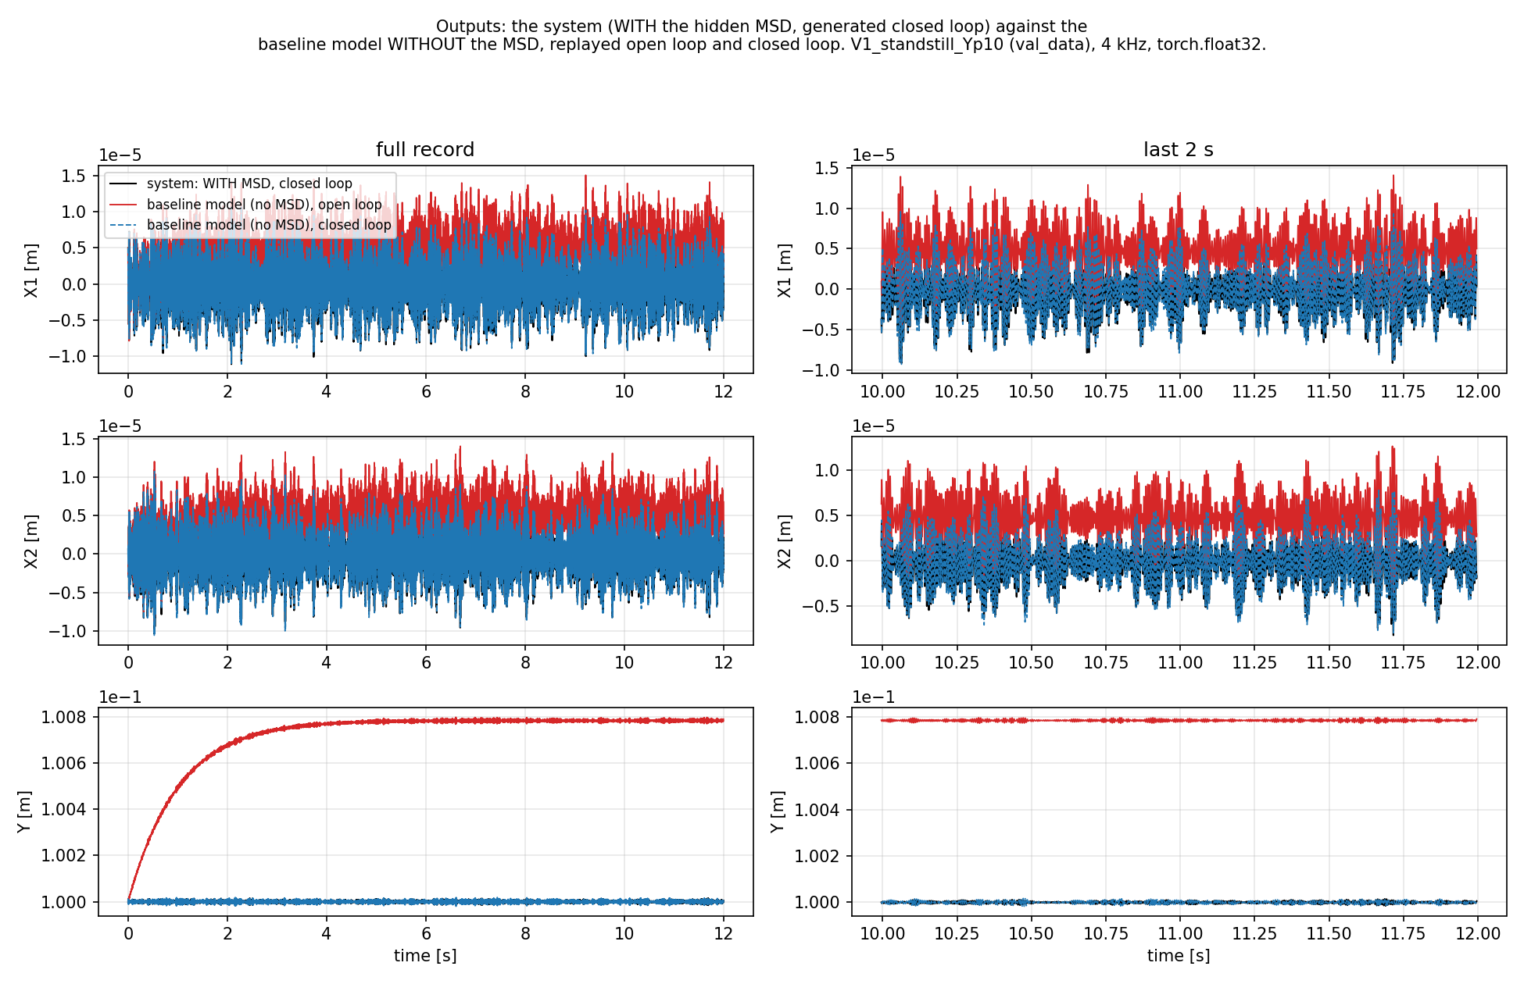

Slide 44
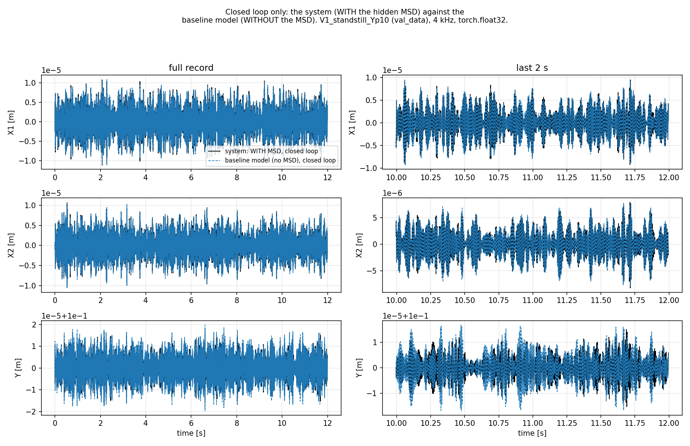

Slide 45
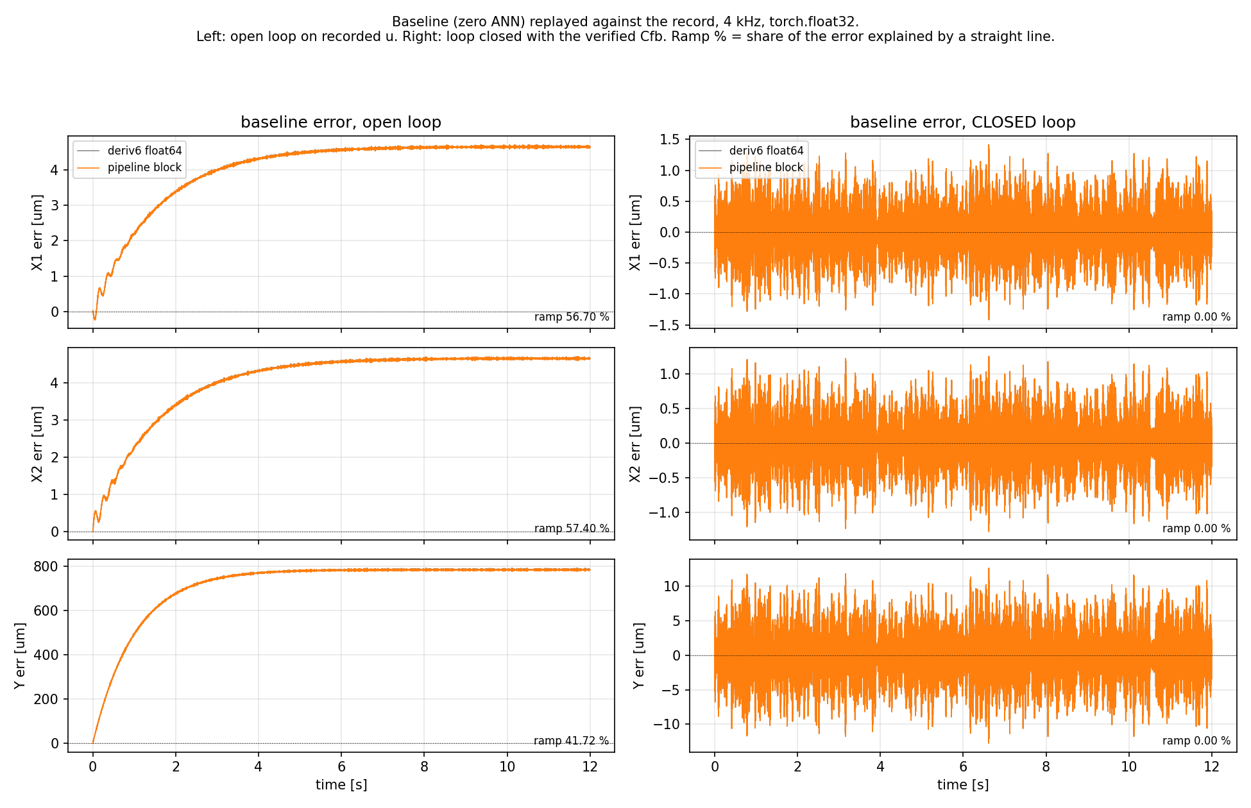

Slide 46
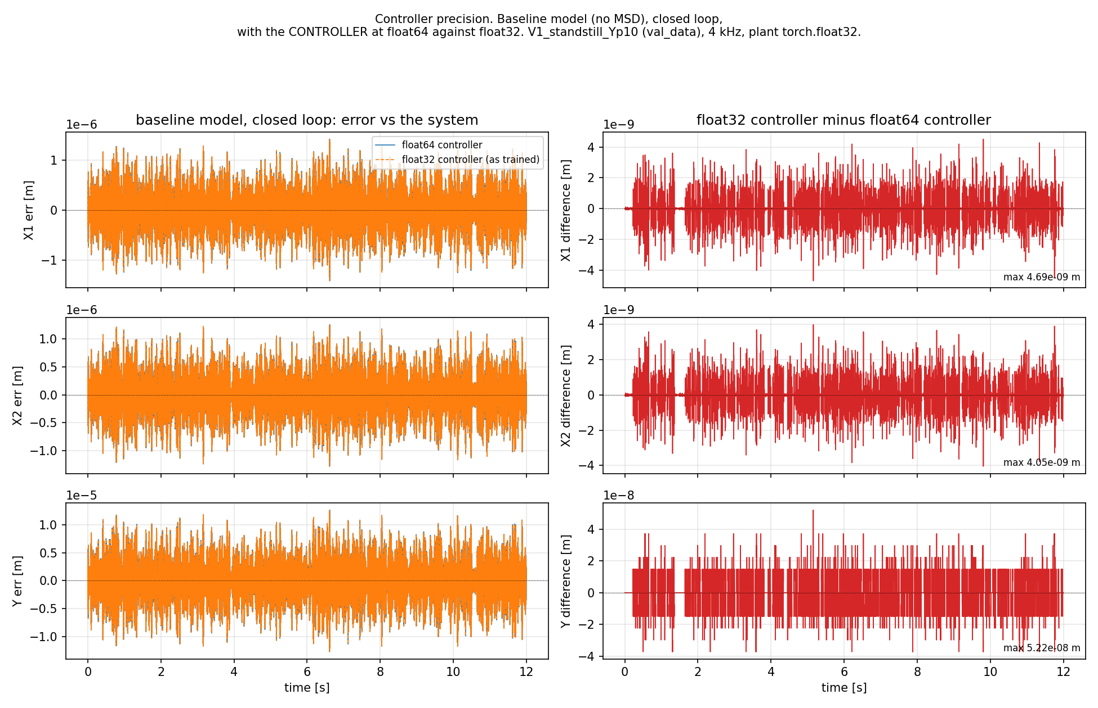

Slide 47
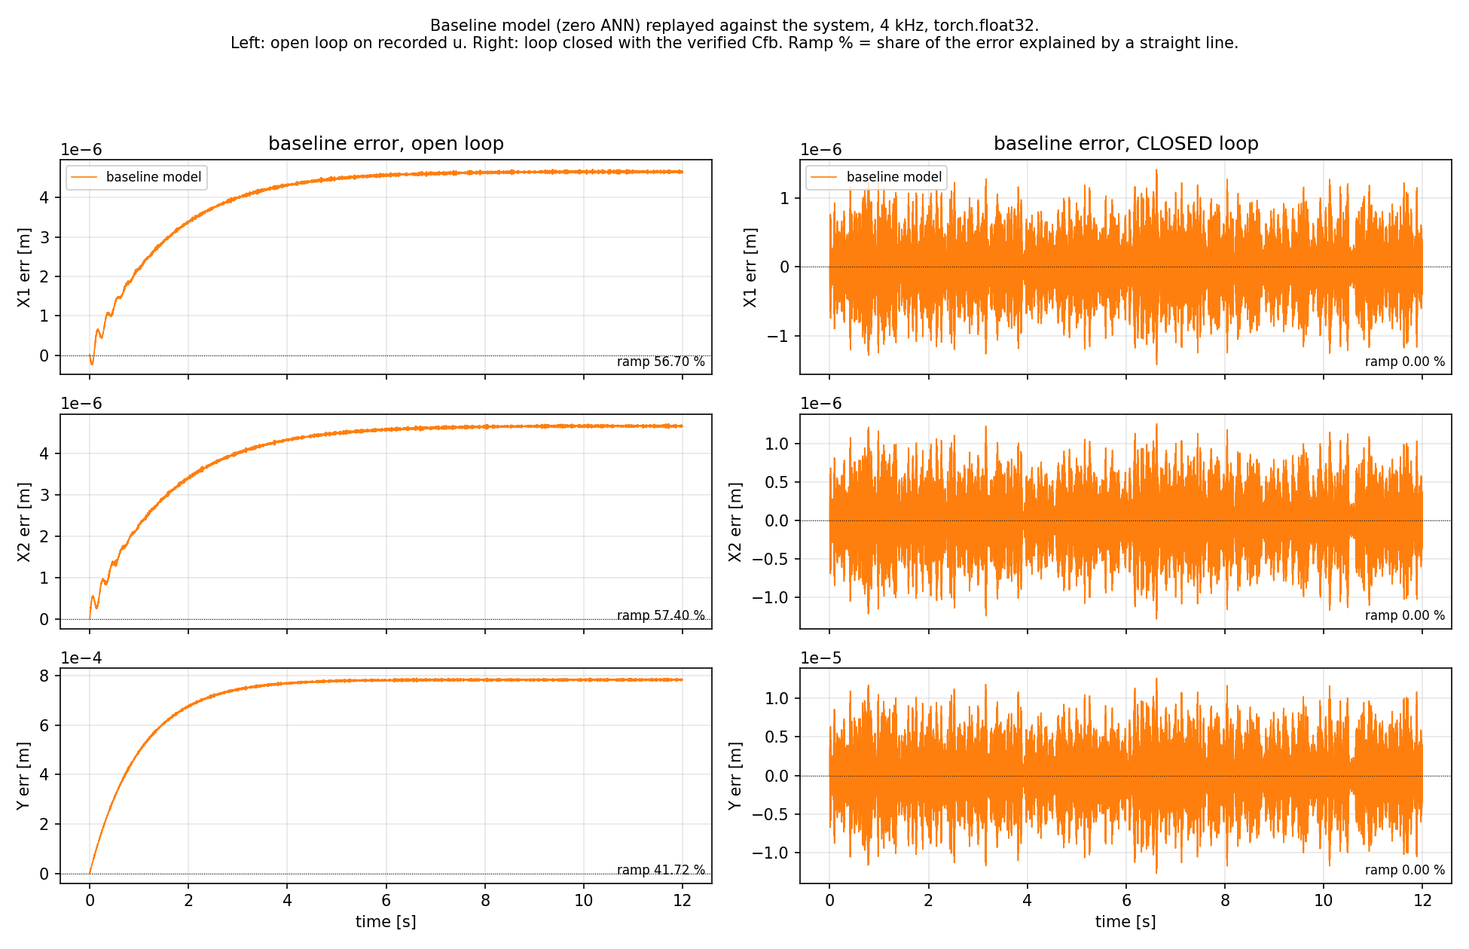

Slide 48
Variant B controller?
Kessels recommened variant A??

Slide 49
2. Y_OP = 0.10 is hardcoded at train_variants.py:52, one controller for all 14 training records. But the records were generated with a per-record operating point (D-039)
So the accurate statement is: the controller removes the offset and amplifies the resonance. Not "the controller does not fix the issue".
currently we were under the impression that we get an offset due to the open-loop closed-loop mismatch and that were dynamics of circa 6 seconds. because the ANN is unable to learn / improve over the linear encoder init with ANN-off we thought this was due to slow dynamcis which the window cant see, but currently that no longer seems to be the case.

Slide 50
horizon, lr

